Slide 1
Control Depth 3D
Depth aware 3D image editing

Slide 2
Introduction
Traditional 3D scene editing requires specialized tools and expertise.
Neural Radiance Fields (NeRF) have revolutionized 3D scene representation.
Our system allows users to make high-level, semantic changes to a 3D scene — such as "add snow" or "make it night-time"
Unlike prior methods that use only 2D models for guidance, our approach leverages depth information to preserve scene structure and spatial consistency during the editing process.

Slide 3
Prior Work
Instruct-NeRF 2 NeRF enabled text-guided edits by updating one view via Instruct Pix2Pix, then fine-tuning NeRF with the edited image.
CLIP-NeRF: Utilizes CLIP-based text-to-image alignment to guide NeRF scene generation
EditNeRF: Introduces shape and appearance edits to NeRF by leveraging explicit supervision, allowing controlled modifications to 3D scenes.
Limitations
Instruct-NeRF NeRF does not enforce geometric alignment across views, leading to artifacts in 3D reconstruction.
CLIP-NeRF Weak geometry preservation; no consistent multi-view coherence or depth-aware guidance.
EditNeRF Requires manual input like segmentation masks, limiting ease of use and control.

Slide 4
Problem Statement
3D scene editing using NeRFs often lacks geometric consistency across multiple views.
Why This Happens?
3D consistency requires understanding spatial layout, which is missing without geometric cues.
How Can We Inject 3D Awareness into 2D-Guided Editing?
Solution: Use Depth Maps
Depth maps capture the underlying 3D structure from 2D views.
Conditioning on depth ensures that edits align with the original geometry, maintaining multi-view consistency.

Slide 5
ControlNet
ControlNet
(VAE encoder)

Slide 6
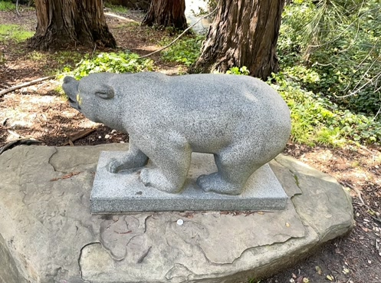
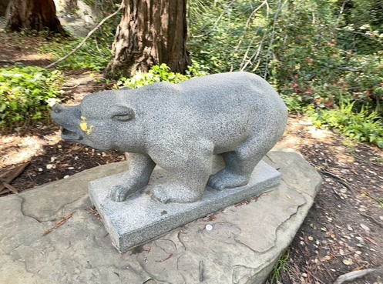
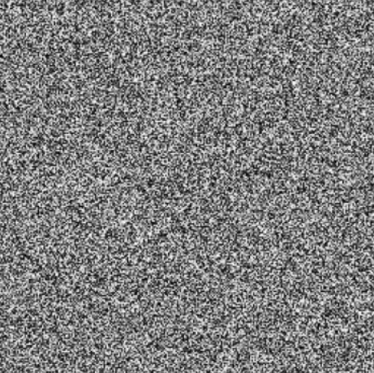
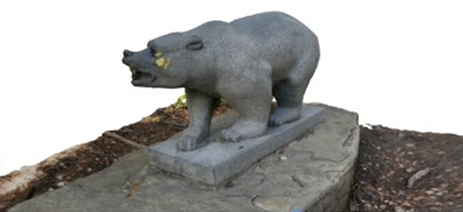
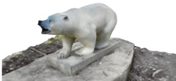
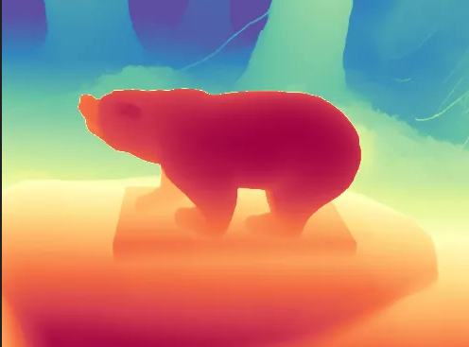
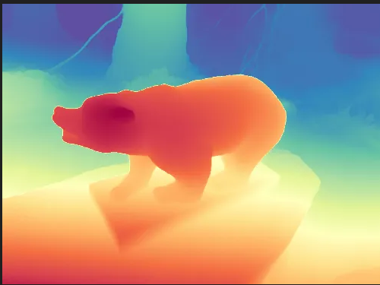
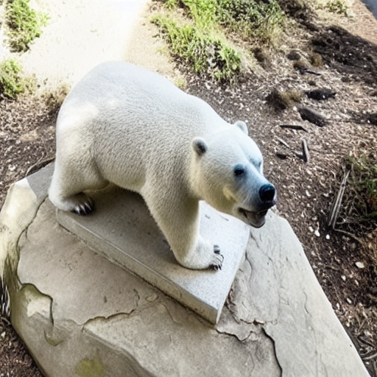
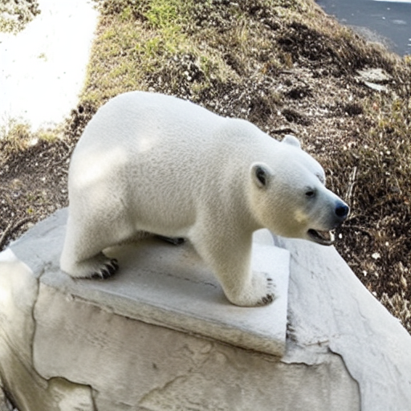
Methodology
Cross Attention
2D views
Reference Views
“A Polar Bear”
Nerf
3D Scene
Z^{T}
ControlNet
(VAE encoder)
3D Scene
Z^{T}
Nerf
ControlNet(VAE decoder)

Slide 7
Methodology
Combine NeRF for 3D scene reconstruction with ControlNet for structured, depth-aware guidance.
Extract depth maps from original images to condition the 3D scene edit, preserving geometric consistency.
Use depth-aware ControlNet to enforce structural edits while maintaining the 3D integrity of the scene.
Use cross attention between the “to be edited” image latent and “reference views” latents.

Slide 8
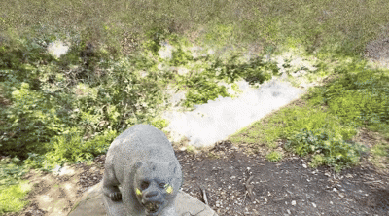
Working and outputs
Original Scene trained with Nerf

Slide 9
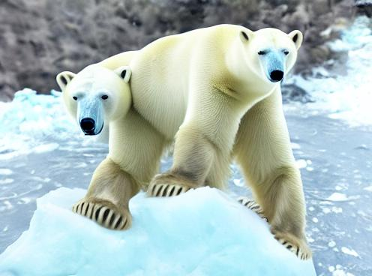
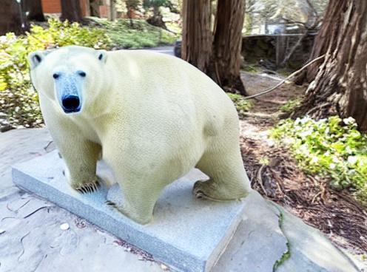
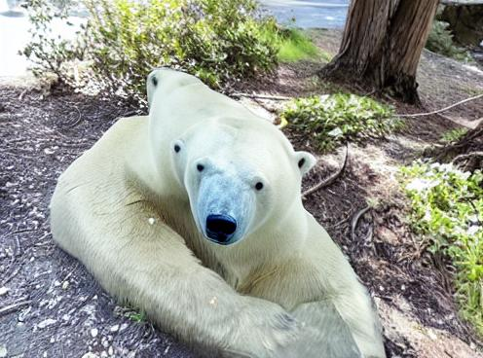
Experiments & Results
Pixel2pixel
“Convert it into a polar bear”
Inconsistent edit across views.
Change in structure of the image.

Slide 10
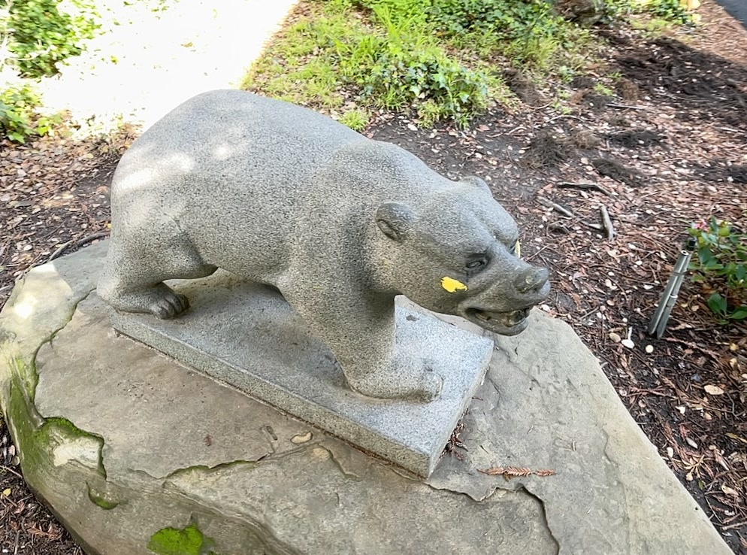

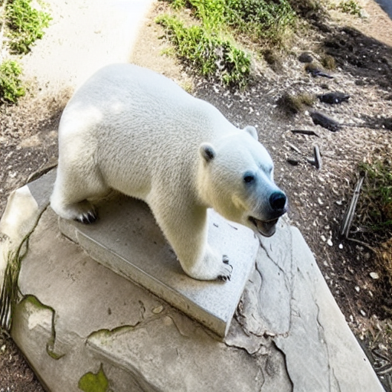
Experiments & Results
2. ControlNet
“A Polar Bear”

Slide 11
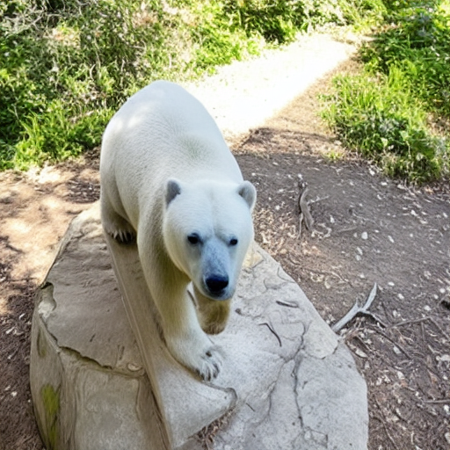
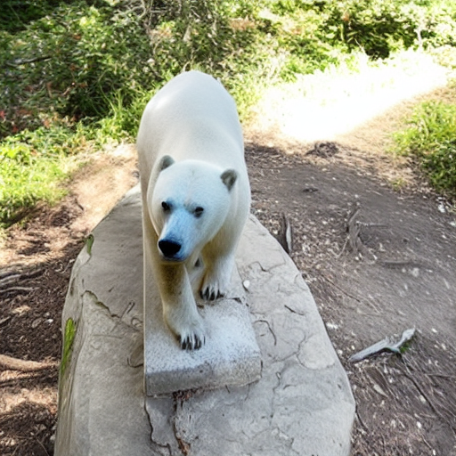
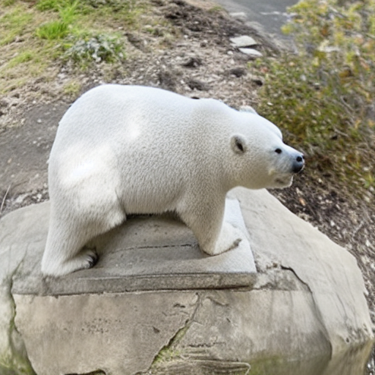
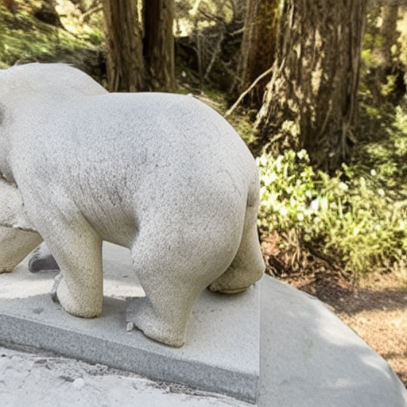
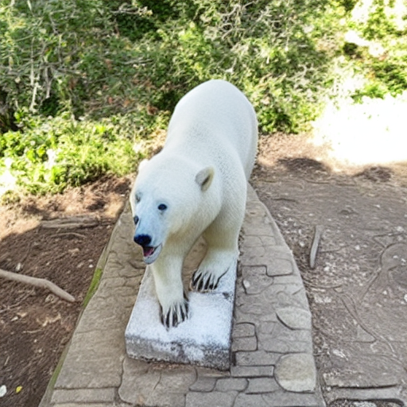
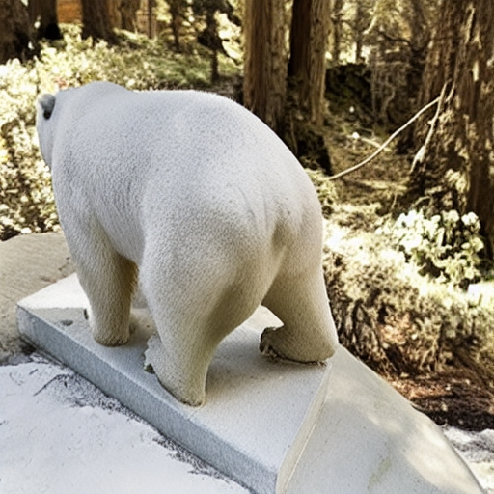
Experiments and Results

Slide 12
Limitations

Slide 13
Future Work

Slide 14
Conclusion

